Slide 1
Investigating Sublimation of Complex Mixtures of H₂O and D₂O
Audrey Smith and Will Grundy
Astrophysical Materials Laboratory

Slide 2
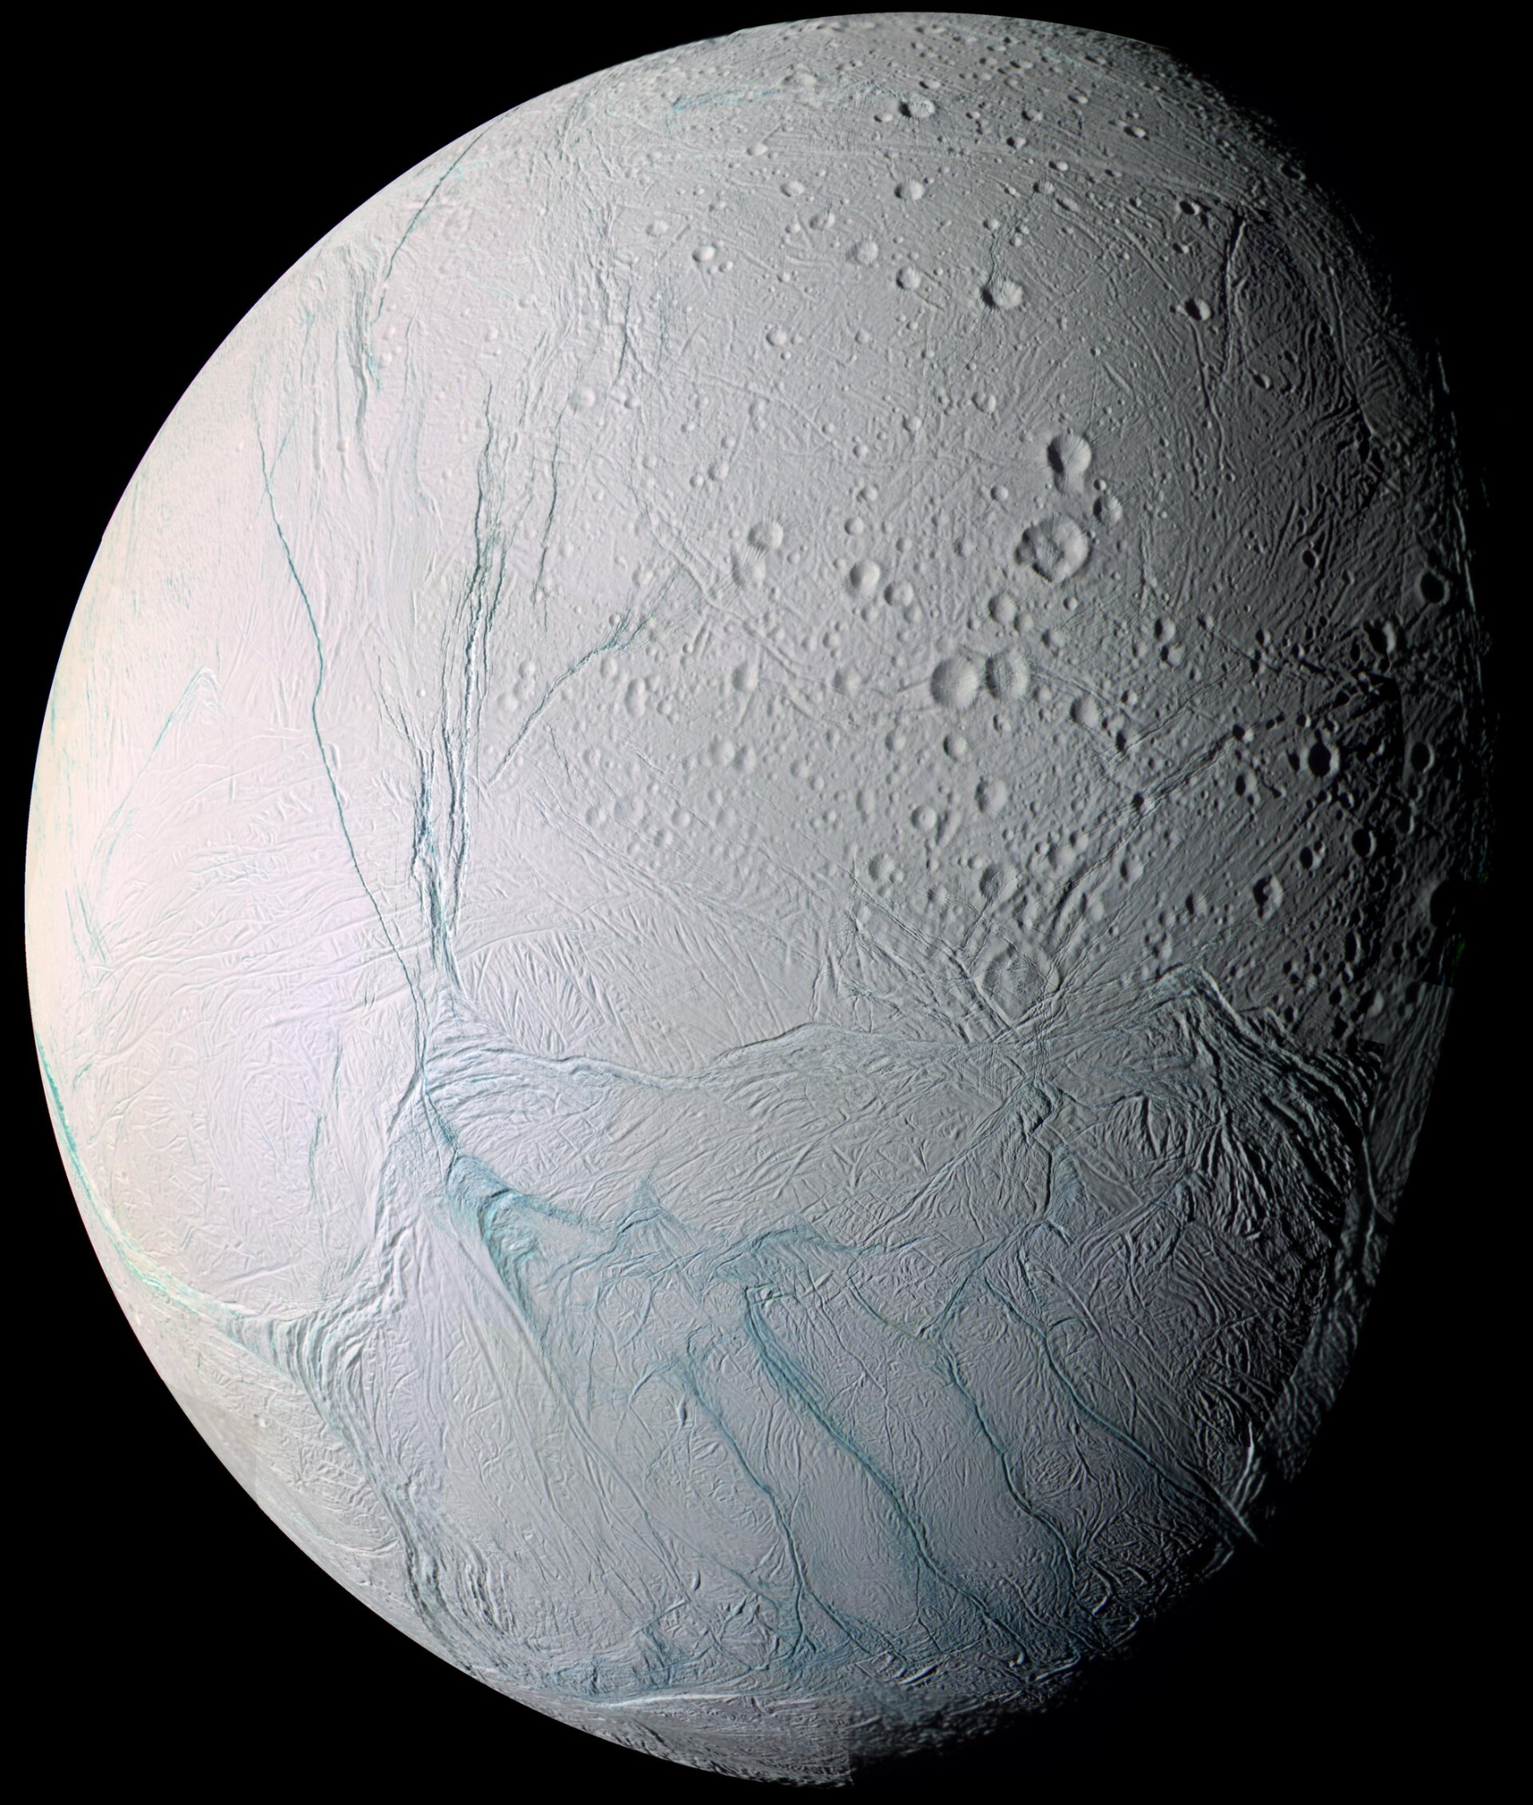
Background
Evolution of icy bodies in the outer solar system.
Varying ratios of H₂O, D₂O, and HDO exist on icy bodies.
The vapor pressure of these influences sublimation rates, outgassing processes, and deuterium-to-hydrogen (D/H) ratios.
Preferential sublimation of H₂O ice in a mixture.
Affects the observed D/H ratios and may contribute to isotopic fractionation.
Image Credit: NASA

Slide 3
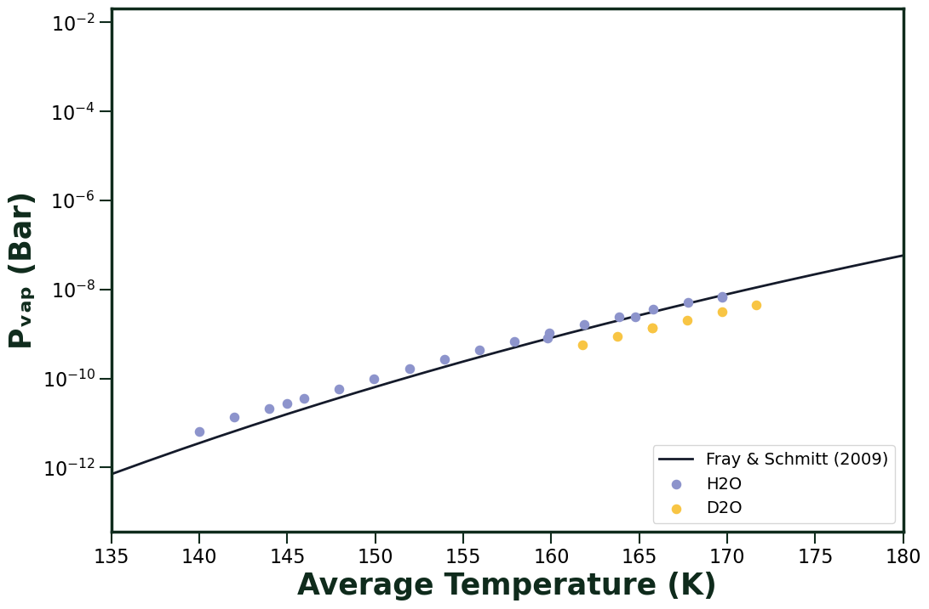
Previously…
H₂O and D₂O fitted to polynomial from Fray & Schmitt (2009)
No previous vapor pressure measurement for D₂O
D₂O found to be systematically below H₂O

Slide 4
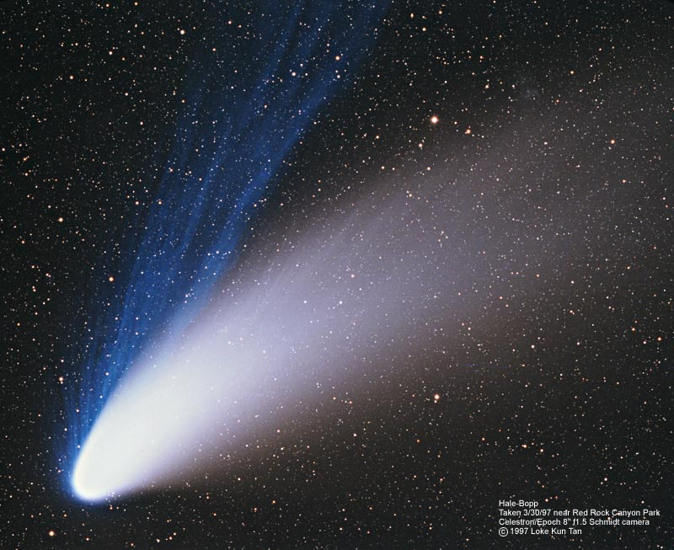
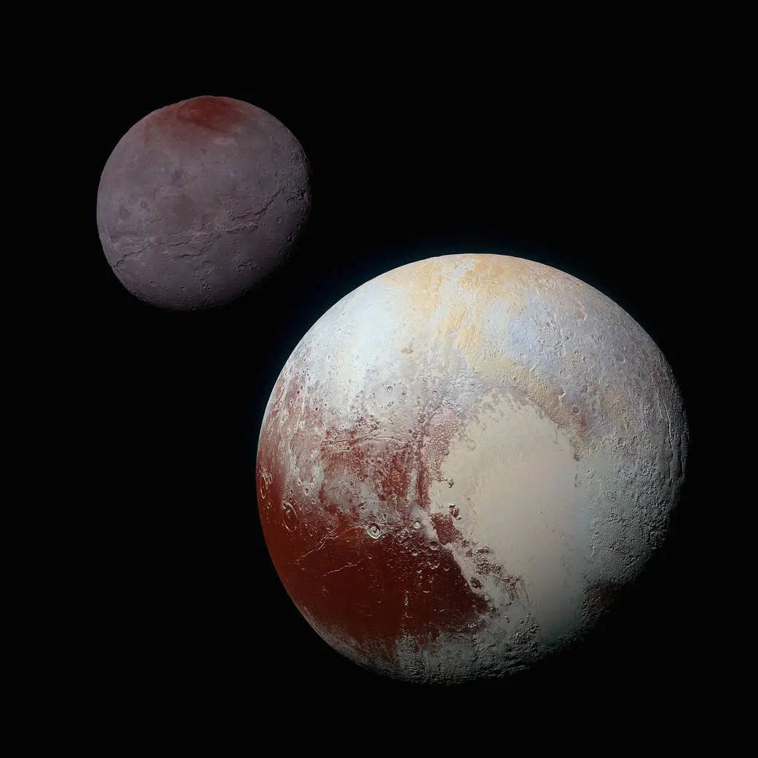
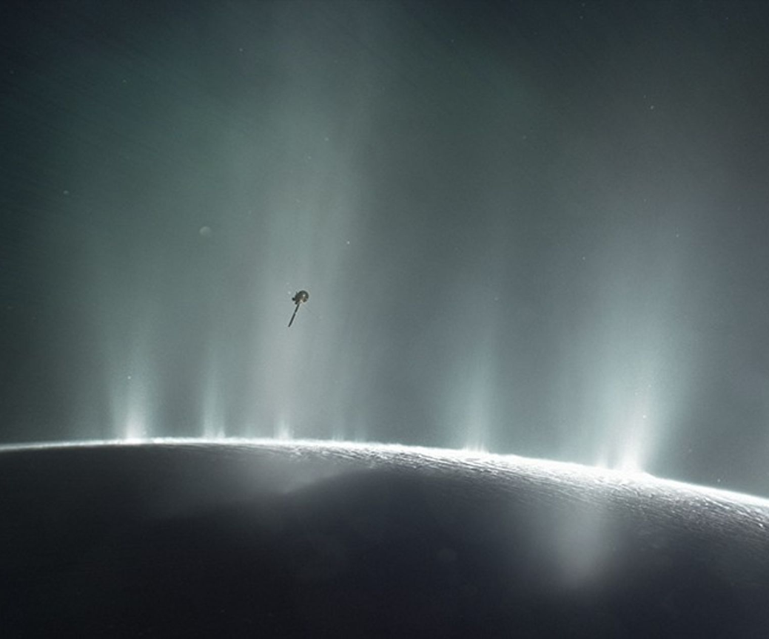
Why do we care about mixtures?
Image Credit: Loke Kun Tan
Image Credit: NASA
Image Credit: NASA

Slide 5
Why do we care about mixtures?
Comets preserve primordial D/H ratios from the early solar nebula.
Without lab data on mixture sublimation kinetics, you cannot correctly interpret cometary D/H measurements to reconstruct solar system formation conditions.
Image Credit: NASA
Image Credit: NASA

Slide 6
Why do we care about mixtures?
Comets preserve primordial D/H ratios from the early solar nebula.
Without lab data on mixture sublimation kinetics, you cannot correctly interpret cometary D/H measurements to reconstruct solar system formation conditions.
Kuiper Belt Objects and Trans-Neptunian Objects (TNOs) experience extremely slow, low-temperature sublimation.
Isotopic mixture effects govern which species escape to space versus remain trapped, directly affecting surface composition evolution over billions of years.
Image Credit: NASA

Slide 7
Why do we care about mixtures?
Comets preserve primordial D/H ratios from the early solar nebula.
Without lab data on mixture sublimation kinetics, you cannot correctly interpret cometary D/H measurements to reconstruct solar system formation conditions.
Kuiper Belt Objects and Trans-Neptunian Objects (TNOs) experience extremely slow, low-temperature sublimation.
Isotopic mixture effects govern which species escape to space versus remain trapped, directly affecting surface composition evolution over billions of years.
For a little closer to home:
Saturn's moon Enceladus vents water-rich plumes.
Interpreting the plume D/H requires understanding how the H₂O/D₂O mixture fractionate as they travel from ocean → ice → vapor.

Slide 8
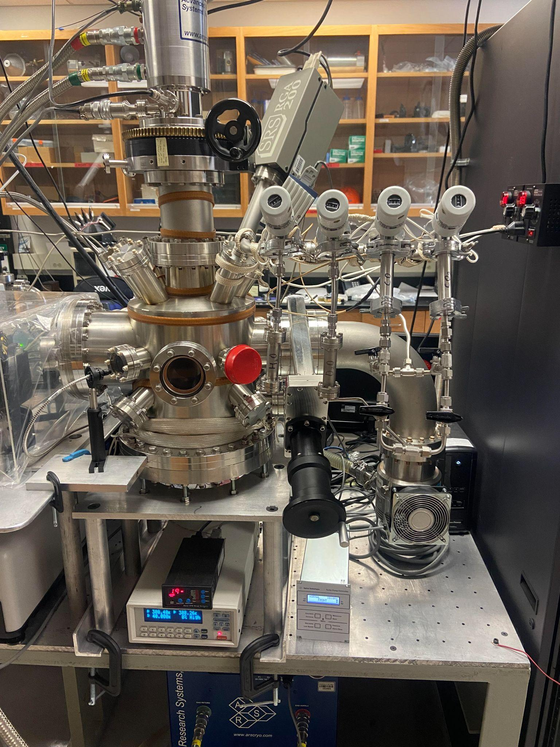
Experiment
Same system as Trisha Lucas
  Except Qualitative Leak Valves used
Sample is deposited at 120K as close to 50% H₂O and 50% D₂O as possible
  Proton exchange is likely happening at this stage
Sample is heated up to 160K
  To change ice phase

Slide 9
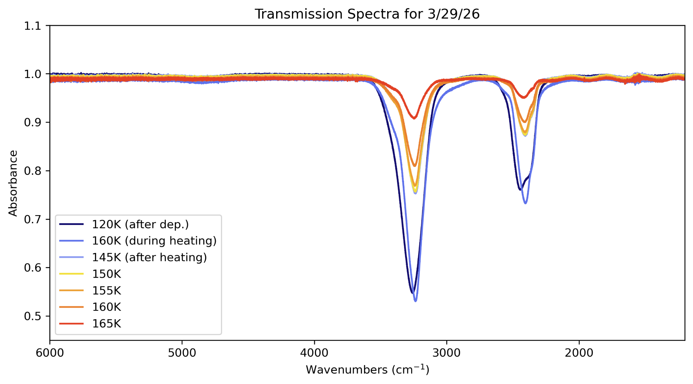
Questions and Fixes
Accuracy of mixture?
  Take spectra.
Composition of mixture?
  Take spectra.
Repeatability of mixture?
  Take spectra.
O-D stretch
O-H stretch

Slide 10
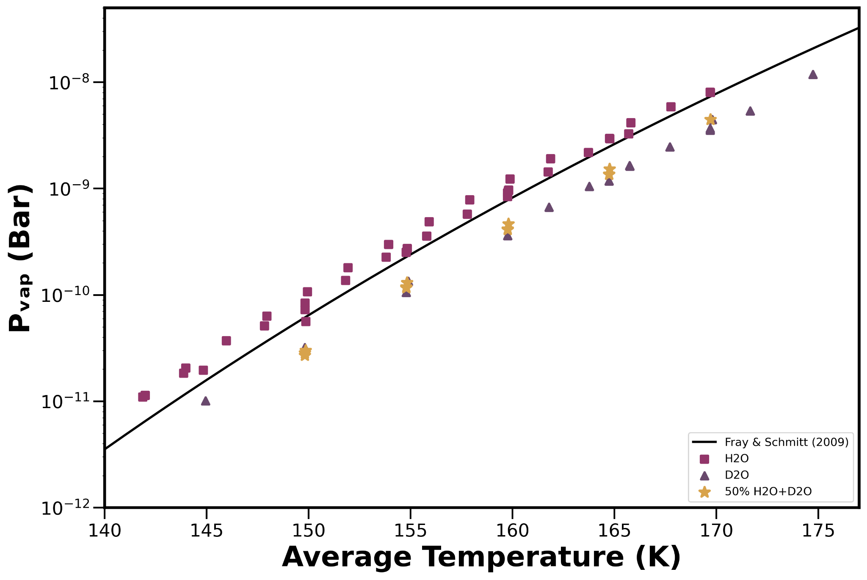
Results
50/50 mixture vapor pressure falls closer to D₂O
  We thought that it would be halfway be H₂O and D₂O

Slide 11



Thanks!
Do you have any questions?
ass283@nau.edu

